Slide 1

503111
Java Technology
HIBERNATE

Slide 2
Outline
Hibernate Overview
Environment Setup
Configurations
Entity & Mapping
Hibernate Query Language
Relationships

Slide 3
What is JDBC?
JDBC stands for Java Database Connectivity.
It provides a set of Java API for accessing the relational databases from Java program.
These Java APIs enables Java programs to execute SQL statements and interact with any SQL compliant database.

Slide 4
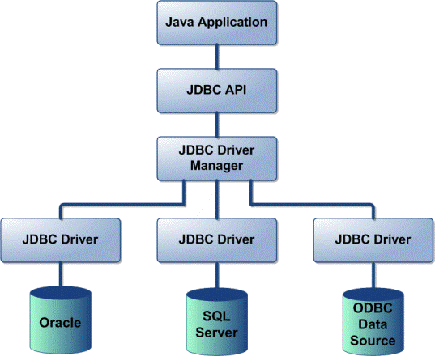
What is JDBC?

Slide 5
JDBC Pros and Cons
Pros:
Clean and simple SQL processing
Good performance with large data
Very good for small applications
Simple syntax so easy to learn
Cons:
Complex if it is used in large projects
Large programming overhead
No encapsulation
Hard to implement MVC concept
Query is DBMS specific

Slide 6
Java ORM Frameworks
There are several persistent frameworks and ORM options in Java.
A persistent framework is an ORM service that stores and retrieves objects into a relational database.
Enterprise JavaBeans Entity Beans
Java Data Objects
Castor
TopLink
Spring DAO
Hibernate
And many more

Slide 7
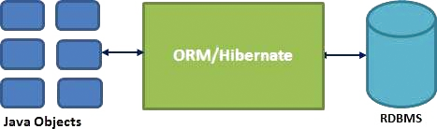
Hibernate Overview
Hibernate is an Object-Relational Mapping (ORM) solution for JAVA.
Hibernate sits between traditional Java objects and database server to handle all the works in persisting those objects based on the appropriate O/R mechanisms and patterns.

Slide 8
Hibernate Advantages
Hibernate takes care of mapping Java classes to database tables using XML files and without writing any line of code.
Provides simple APIs for storing and retrieving Java objects directly to and from the database.
If there is change in the database or in any table, then you need to change the XML file properties only.
Abstracts away the unfamiliar SQL types and provides a way to work around familiar Java Objects.
Hibernate does not require an application server to operate.
Manipulates Complex associations of objects of your database.
Minimizes database access with smart fetching strategies.
Provides simple querying of data.

Slide 9
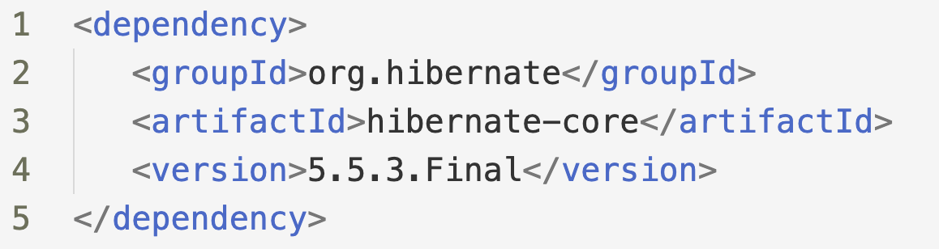
Environment Setup
System Requirements:
Hibernate 5.2 and later versions: at least Java 1.8 and JDBC 4.2.
Hibernate 5.1 and older versions: at least Java 1.6 and JDBC 4.0.
Hibernate with Maven:

Slide 10
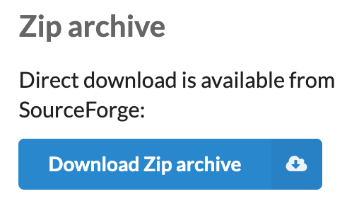
Environment Setup
Traditional approach:
Download Hibernate at https://hibernate.org/orm/releases/5.4/

Slide 11
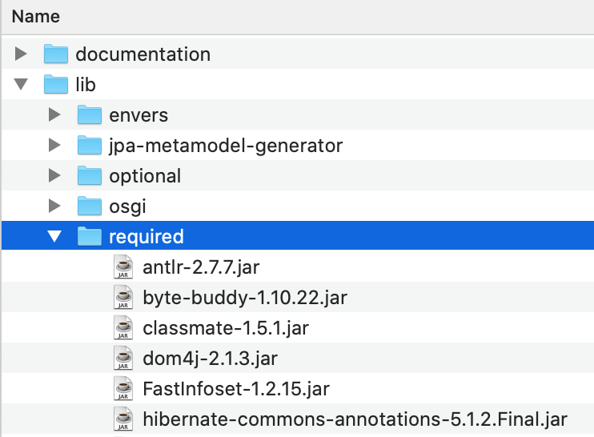
Environment Setup
Traditional approach:
2. Extract the hibernate-release-5.4.32.Final.zip file to a specific location

Slide 12
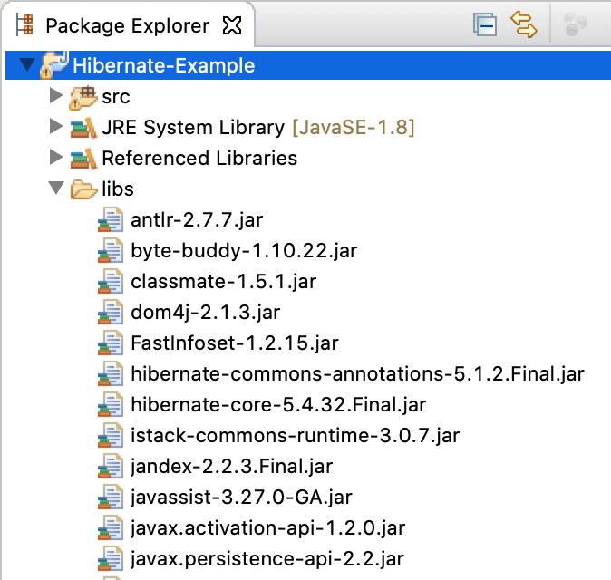
Environment Setup
Traditional approach:
3. Copy all the *.jar file from the required folder to the class path of java project

Slide 13
Configurations
Hibernate requires to know in advance: where to find the mapping information that defines how your Java classes relate to the database tables.
All such information is usually supplied as an XML file named hibernate.cfg.xml.
This configuration file is placed at the src folder in the project.

Slide 14
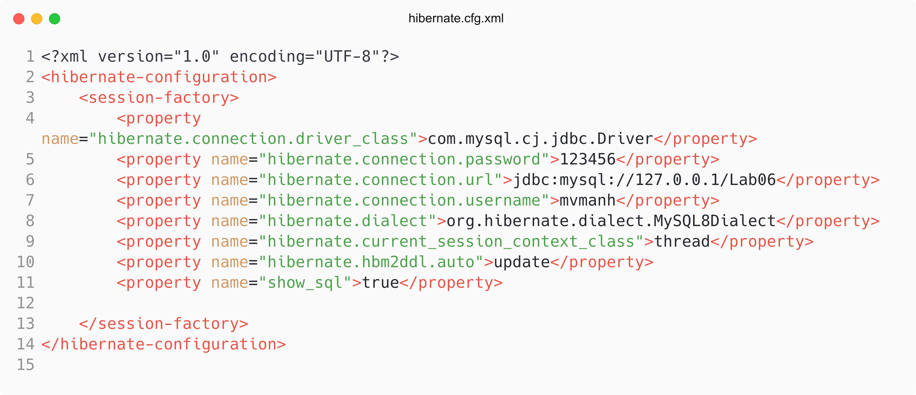
Configurations

Slide 15
Hibernate Properties
Following is the list of important properties, you will be required to configure for a databases:
hibernate.dialect
This property makes Hibernate generate the appropriate SQL for the chosen database.
Ex: org.hibernate.dialect.MySQL8Dialect
hibernate.connection.driver_class
The JDBC driver class.
Ex: com.mysql.cj.jdbc.Driver
hibernate.connection.url
The JDBC URL to the database instance.
Ex: jdbc:mysql://127.0.0.1/Lab06

Slide 16
Hibernate Properties
hibernate.connection.username
The database username.
hibernate.connection.password
The database password.
hibernate.connection.pool_size
Limits the number of connections waiting in the Hibernate database connection pool.
hibernate.connection.autocommit
Allows autocommit mode to be used for the JDBC connection.

Slide 17
Database & Dialect Property
DB2
org.hibernate.dialect.DB2Dialect
HSQLDB
org.hibernate.dialect.HSQLDialect
MySQL
org.hibernate.dialect.MySQLDialect
Progress
org.hibernate.dialect.ProgressDialect
Microsoft SQL Server 2008
org.hibernate.dialect.SQLServer2008Dialect

Slide 18
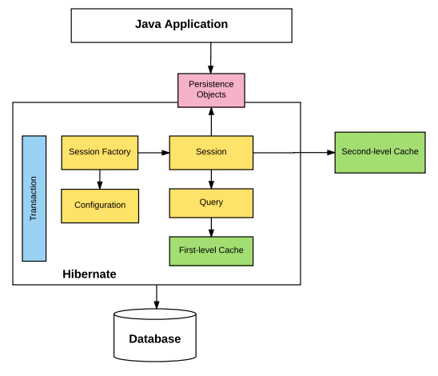
Session

Slide 19
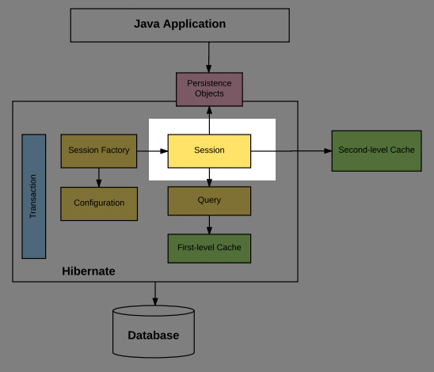
Session

Slide 20
Session
A Session is used to get a physical connection with a database.
Persistent objects are saved and retrieved through a Session object.
The session objects should not be kept open for a long time.
Instances may exist in one of the following three states:
transient − A new instance of a persistent class, which is not associated with a Session and has no representation in the database.
persistent − A persistent instance has a representation in the database, an identifier value and is associated with a Session.
detached − the persistent instance will become a detached instance when Once we close the Hibernate Session.

Slide 21
Persistent Classes
Java classes whose objects will be stored in database tables are called persistent classes in Hibernate.
Hibernate works best if these classes follow some simple rules, also known as the Plain Old Java Object (POJO) programming model.

Slide 22
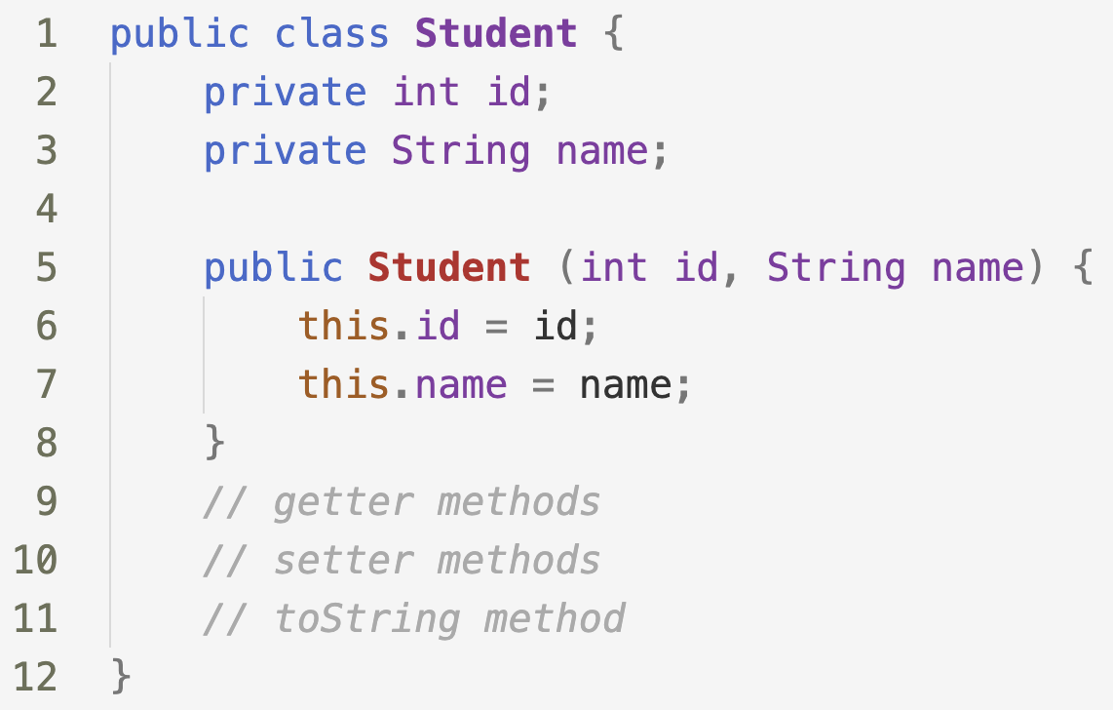
Persistent Classes

Slide 23
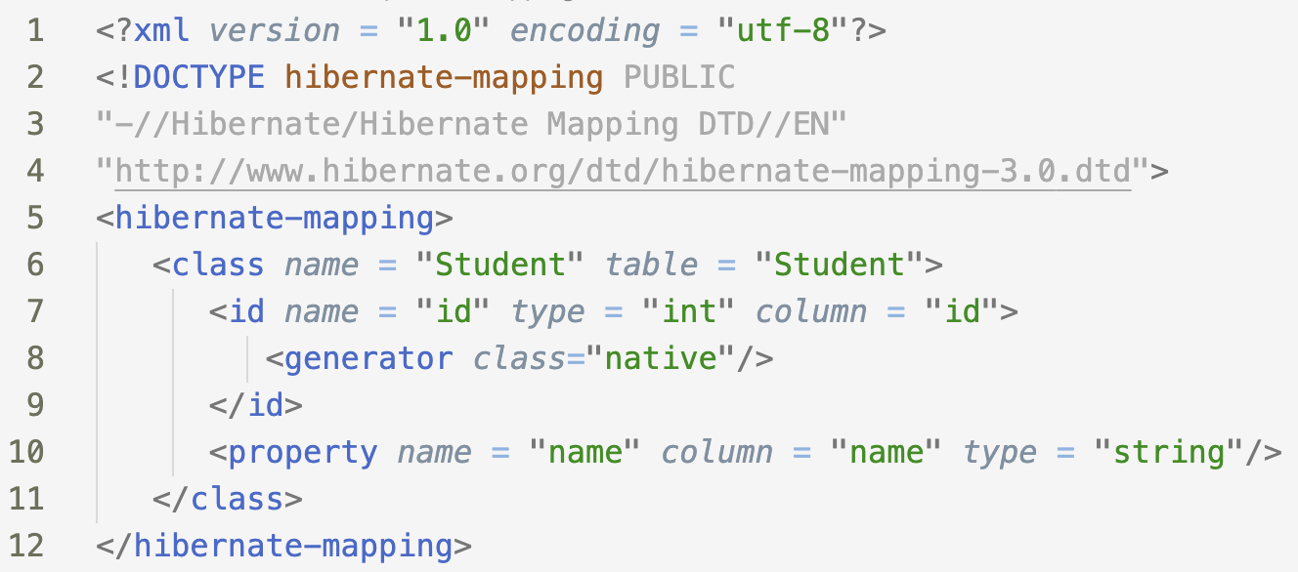
XML Mapping
An Object/relational mappings are usually defined in an XML document.
This mapping file instructs Hibernate — how to map the defined class or classes to the database tables.

Slide 24
Annotation Mapping
Hibernate annotations are the newest way to define mappings without the use of XML file.
You can use annotations in addition to or as a replacement of XML mapping metadata

Slide 25
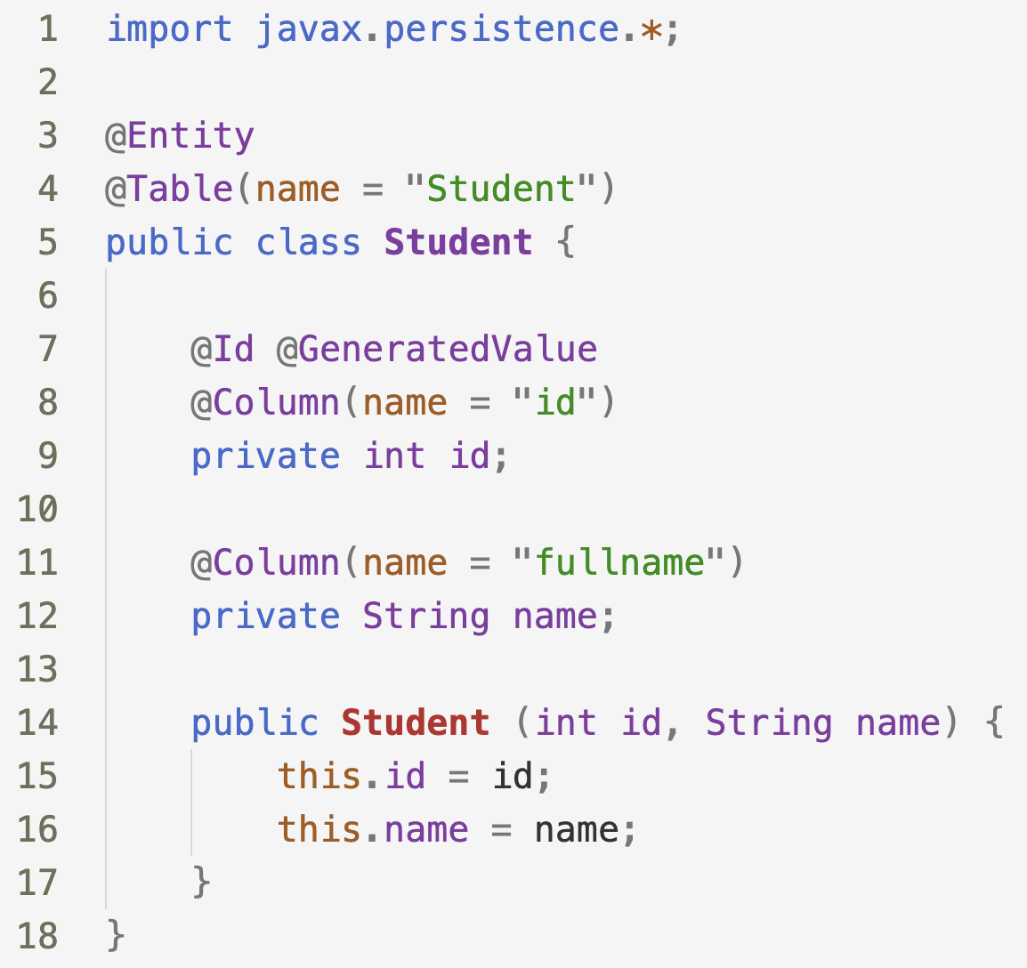
Annotation Mapping

Slide 26
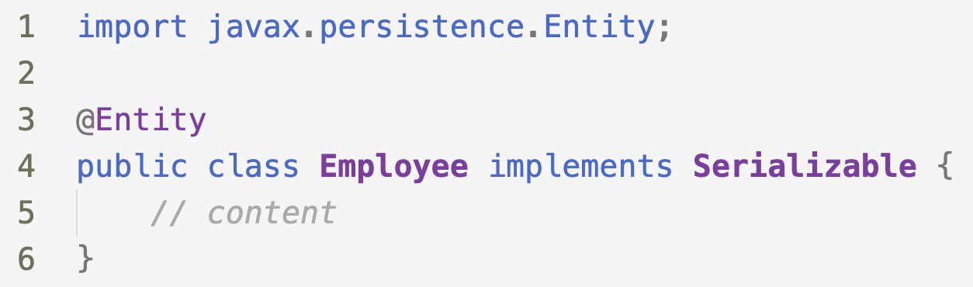
Common Annotations
@Entity: Specifies that the class is an entity. This annotation can be applied on Class, Interface of Enums.

Slide 27
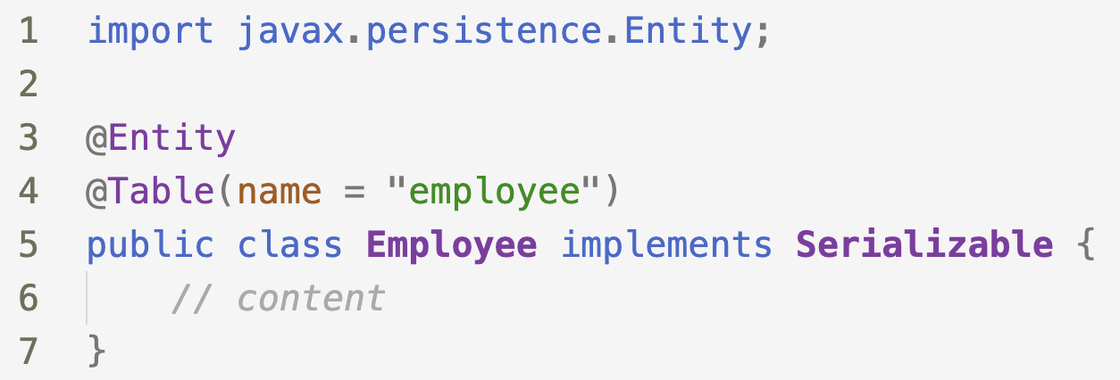
Common Annotations
@Table: it specifies the table in the database with which this entity is mapped.

Slide 28
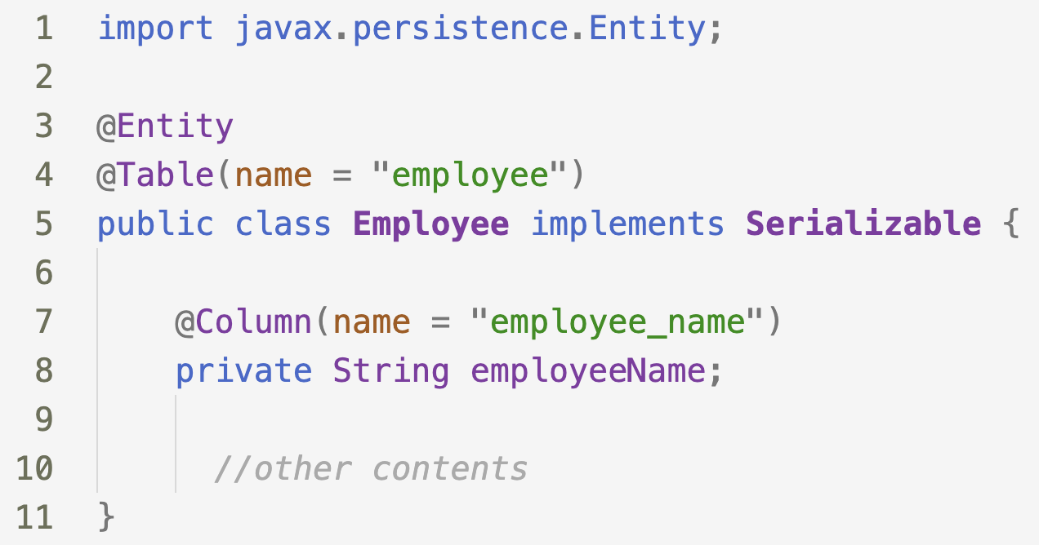
Common Annotations
@Column: Specify the column mapping using @Column annotation.
Name attribute of this annotation is used for specifying the table’s column name.

Slide 29
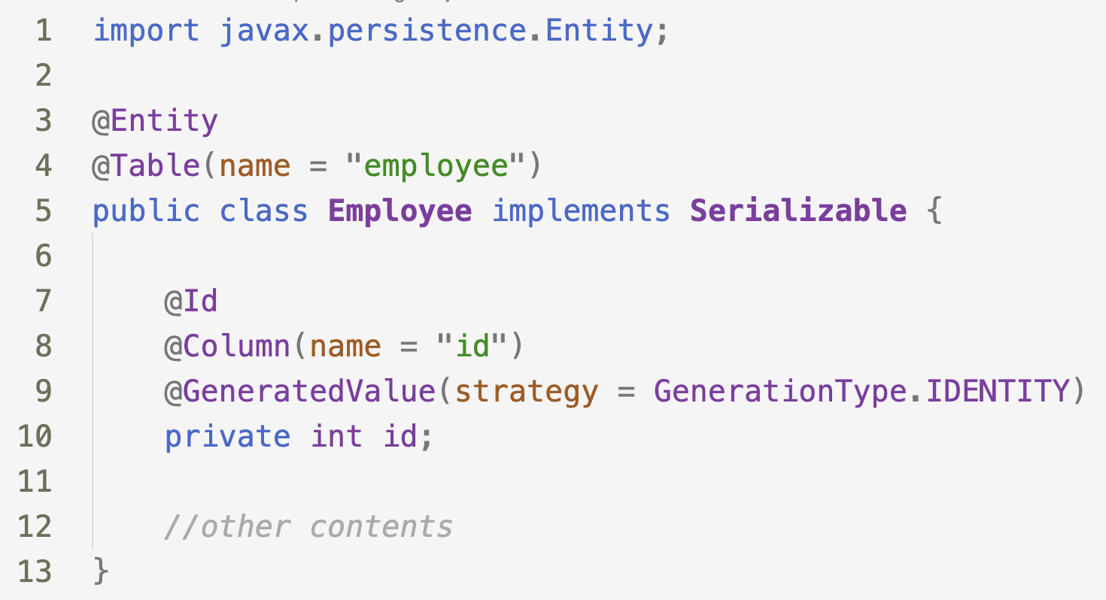
Common Annotations
@ID: This annotation specifies the primary key of the entity.
@GeneratedValue: This annotation specifies the generation strategies for the values of primary keys.

Slide 30
Hibernate Example

Slide 31
Hibernate Example
This example will demonstrate all the steps required to:
Setup the project
Create a Product Entity
Setup an instance of SessionFactory
Create a session instance and save products to MySQL Database

Slide 32
Step 1. Setup the project
Create a maven project
Add Hibernate core dependency
Add Mysql connector dependency
Create hibernate.cfg.xml configuration file

Slide 33
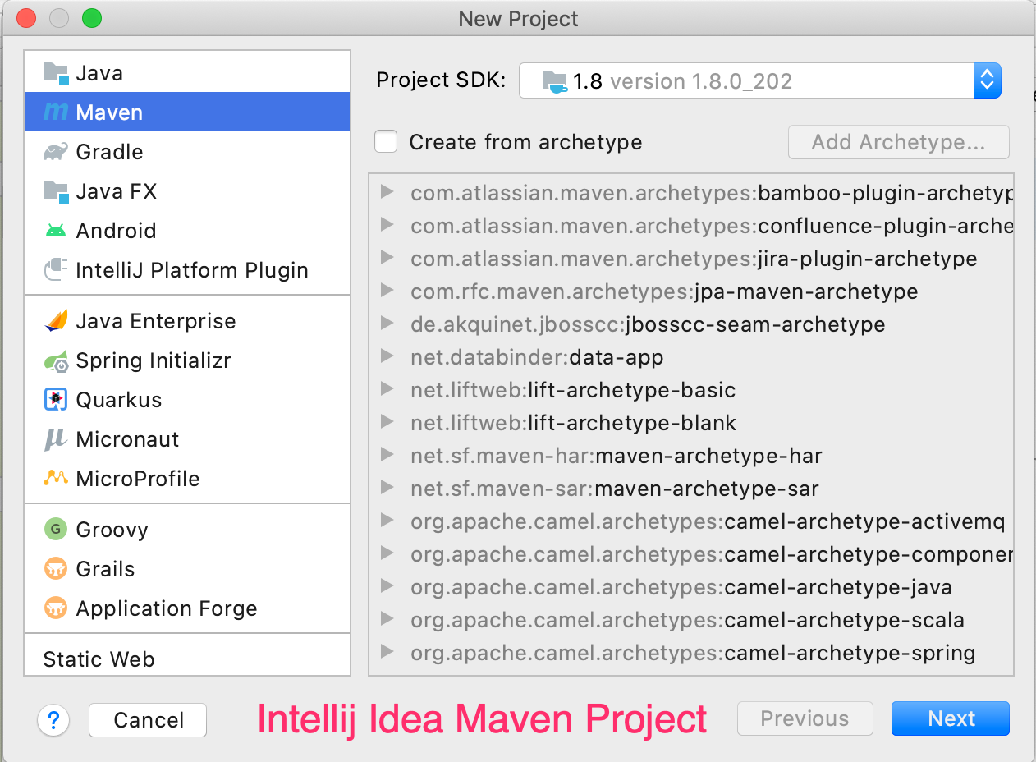
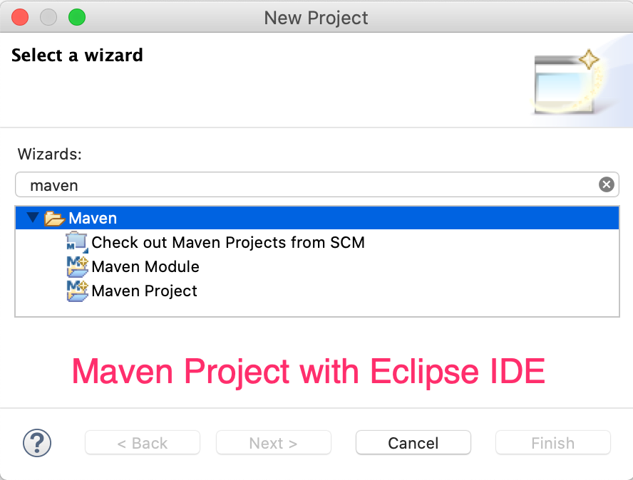
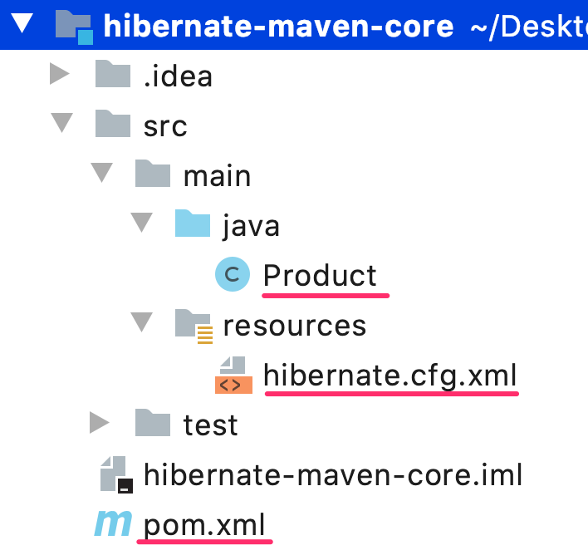

Slide 34
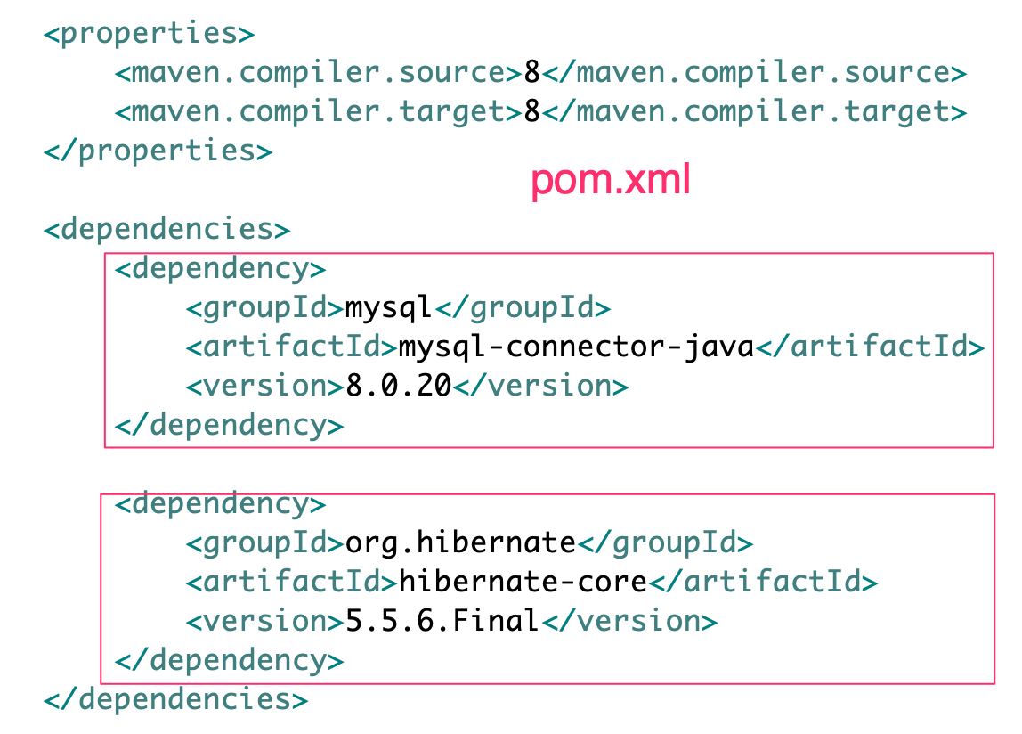

Slide 35
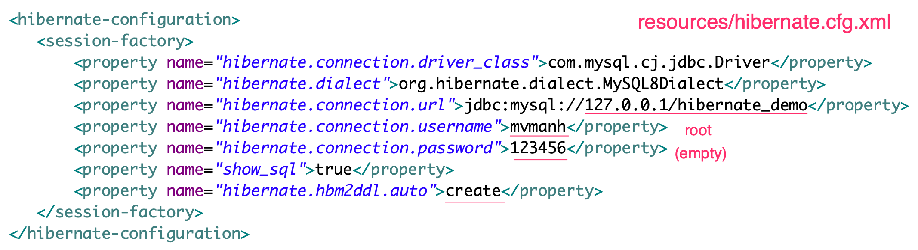

Slide 36
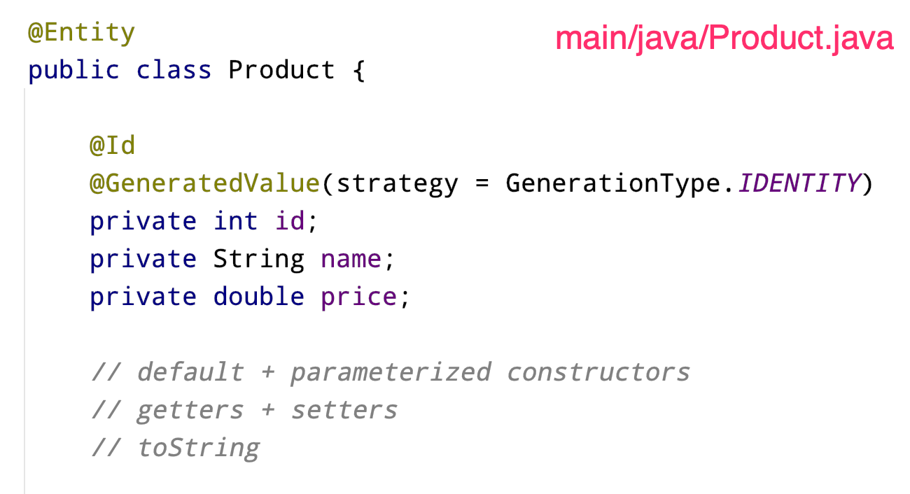

Slide 38
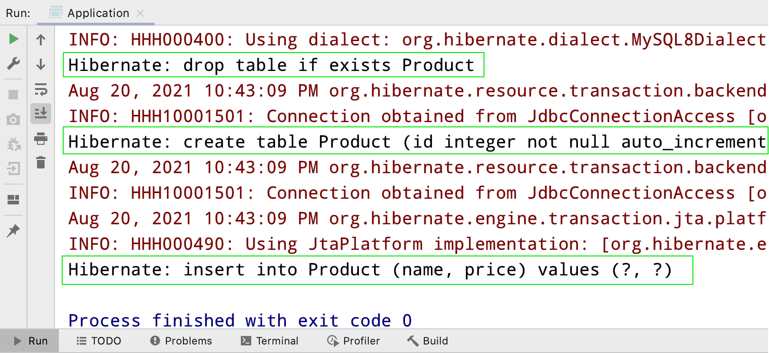

Slide 39
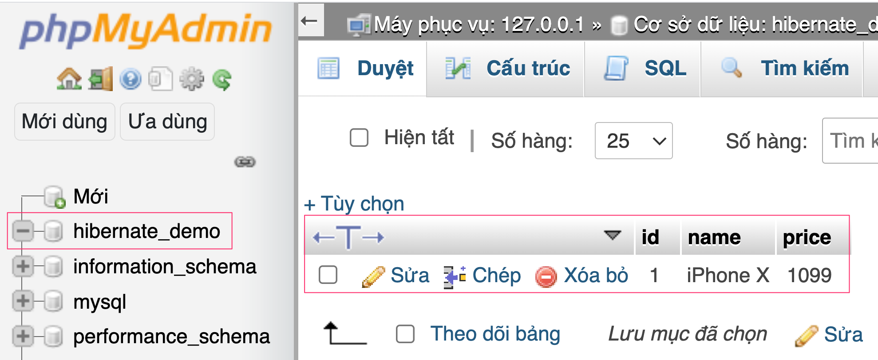

Slide 40
Hibernate Query Language

Slide 41
Hibernate Query Language
HQL is an object-oriented query language, similar to SQL, but instead of operating on tables and columns, HQL works with persistent objects and their properties.
HQL queries are translated by Hibernate into conventional SQL queries, which in turns perform action on database.
You can use SQL statements directly with Hibernate using Native SQL, but I would recommend to use HQL.

Slide 42
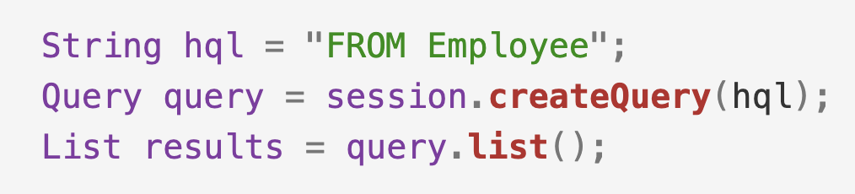
HQL - FROM Clause
You will use FROM clause if you want to load complete persistent objects into memory.
Following is the simple syntax of using FROM clause:

Slide 43
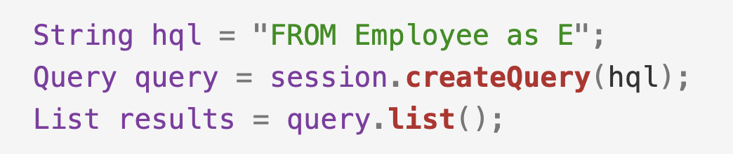
HQL - AS Clause
The AS clause can be used to assign aliases to the classes in your HQL queries, especially when you have the long queries.
For instance, our previous simple example would be the following:

Slide 44
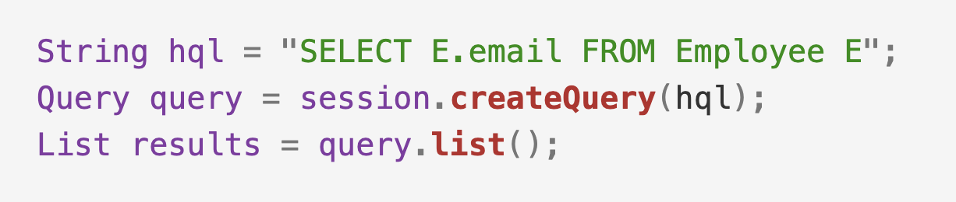
HQL - Select Clause
The SELECT clause provides more control over the result set then the from clause.
If you want to obtain few properties of objects instead of the complete object, use the SELECT clause

Slide 45
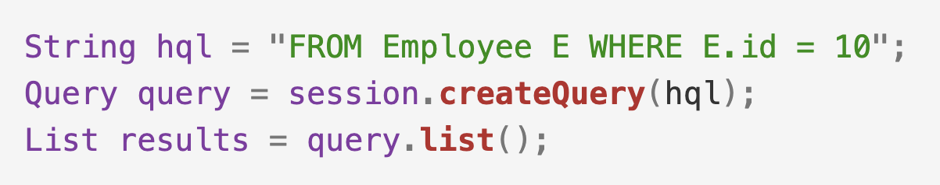
HQL - Where Clause
If you want to narrow the specific objects that are returned from storage, you use the WHERE clause.
Following is the simple syntax of using WHERE clause:

Slide 46
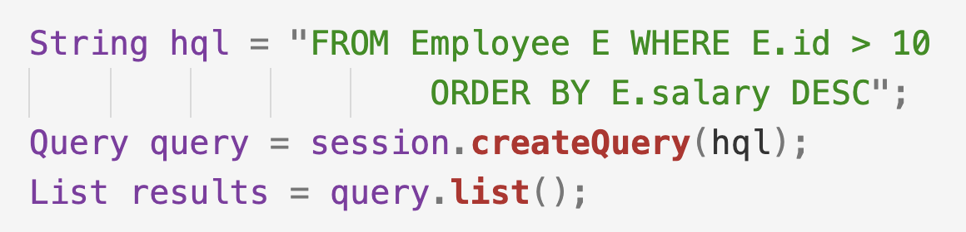
HQL - OrderBy Clause
To sort your HQL query's results, you will need to use the ORDER BY clause.
You can order the results by any property on the objects in the result set either ascending (ASC) or descending (DESC).

Slide 47
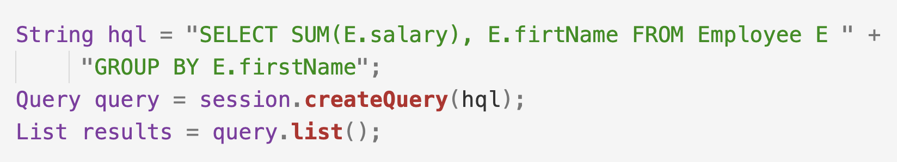
HQL - GroupBy Clause
This clause lets Hibernate pull information from the database and group it based on a value of an attribute and, typically, use the result to include an aggregate value.
Following is the simple syntax of using GROUP BY clause.

Slide 48
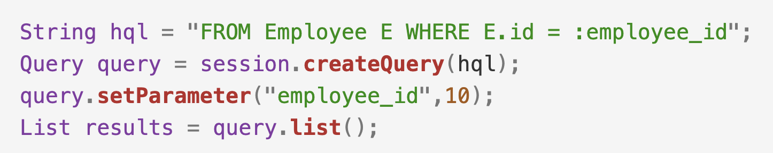
HQL – Named Parameters
Hibernate supports named parameters in its HQL queries.
This makes writing HQL queries that accept input from the user easy and you do not have to defend against SQL injection attacks.

Slide 49
CRUD Operations

Slide 50
The Create Operation
The required steps to create an entity:
Create a new instance of the entity object.
Get a new Session from the SesionFactory object
Open a transaction
Call session.save() method and pass the entity object as parameter.
Commit the transaction
Close the sesision

Slide 52
The Read Operation
The required steps to read an object by its id
Get a new Session from the SesionFactory object
Call the session.get() method, e.g. Product p = session.get(Product.class, id)
Process the object as required.
Close the session

Slide 53
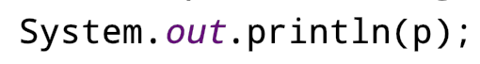

Slide 54
The Read Operation
The required steps to query a list of objects:
Get a new Session from the SesionFactory object
Call the session.createQuery() method and pass the HQL query as parameter
Call the Query.getResultList() to get the result
Process the returned list.

Slide 55
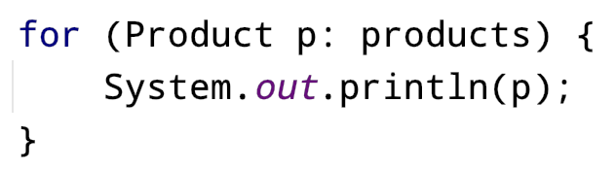


Slide 56
The Update Operation
The required steps to update an object
Get a new Session from the SesionFactory object
Begin a transaction
Load the object from the database
Update the object properties
Call session.save() method to mask the object as being updated entity.
Commit the transaction
Close the session

Slide 57
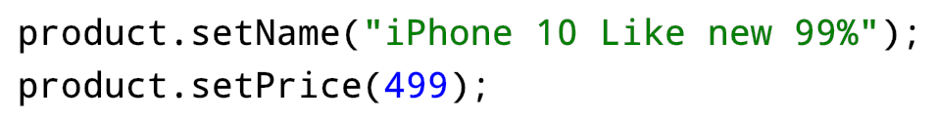
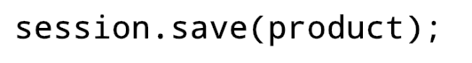
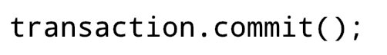


Slide 58
The Delete Operation
The required steps to delete an object
Get a new Session from the SesionFactory object
Begin a transaction
Load the object from the database
Call session.delete() method to mask the object as deleted.
Commit the transaction
Close the session

Slide 59
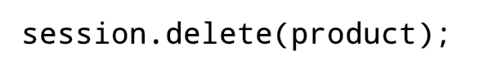

Slide 60
Entity Relationship
One to One Relationship
Many to One Relationship
Many to Many Relationship

Slide 61
One to Many
Relationship

Slide 62
One to One Relationship
We have to use @OneToOne annotation to denote a one-to-one relationship in the entity classes.
In hibernate there are 3 ways to create one-to-one relationships between two entities:
Uses a foreign key column in one of the table.
Use a third table to store mapping between first two tables.
Uses a common primary key value in both the tables.

Slide 63
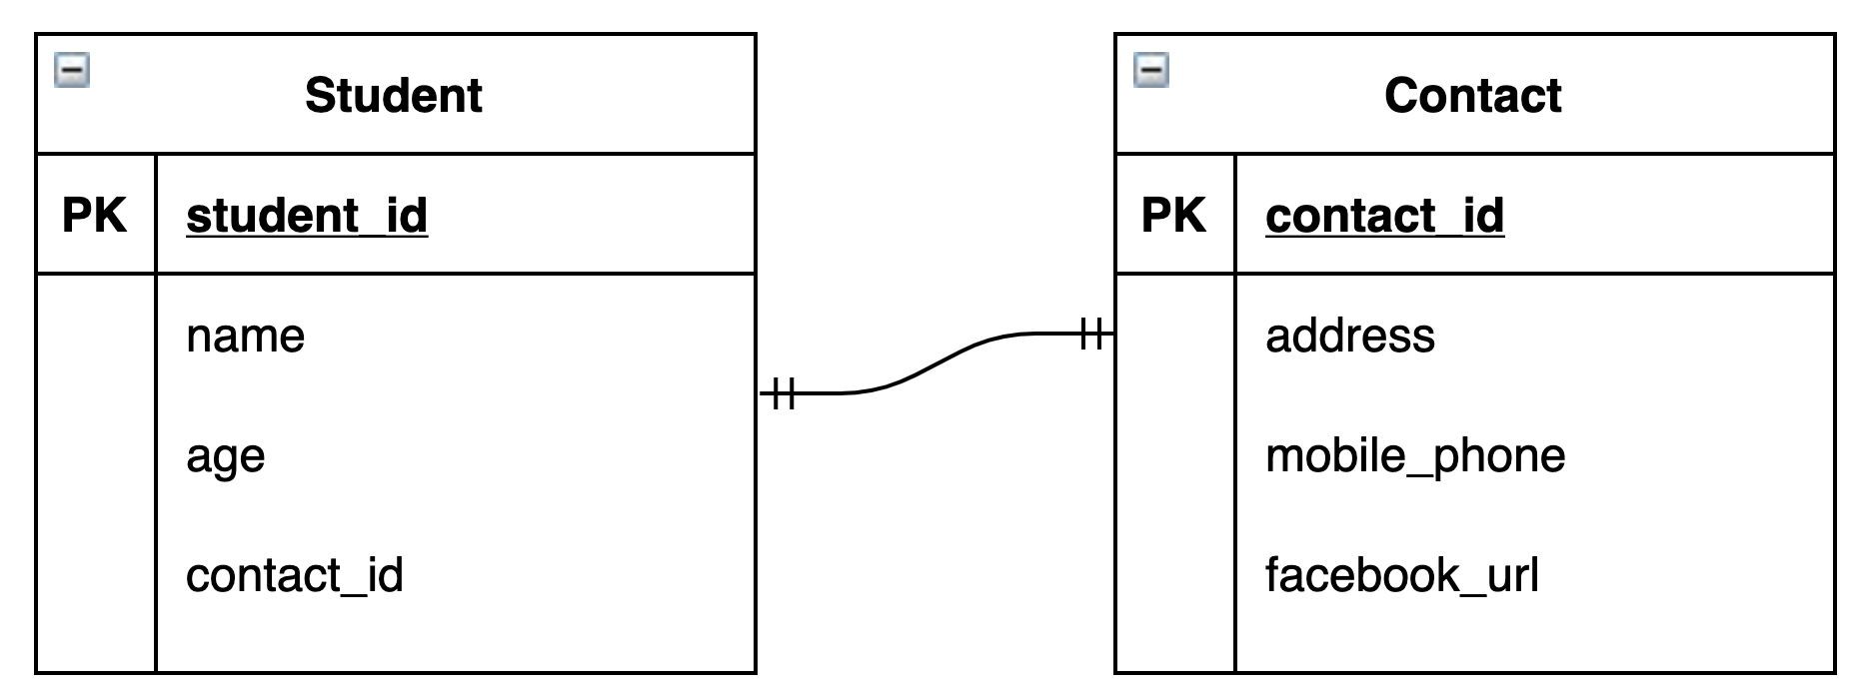
One to One Relationship
1. Uses a foreign key column in one of the table:
In this kind of association, a foreign key column is created in owner entity.
Consider a relationship between Student and Contact:
An extra column contact_id will be created in the student table.
This column will store the foreign key for the Contact table.

Slide 64
One to One Relationship
To make such association, refer the Contact entity in Student class as follow:

Slide 65
In this seup the Student entity is called the owner. The owner is responsible for the association column(s) update.
The other side is also annotated with @OneToOne annotation and the attribute mappedBy need to be specified.

Slide 66
One to Many
Relationship

Slide 67
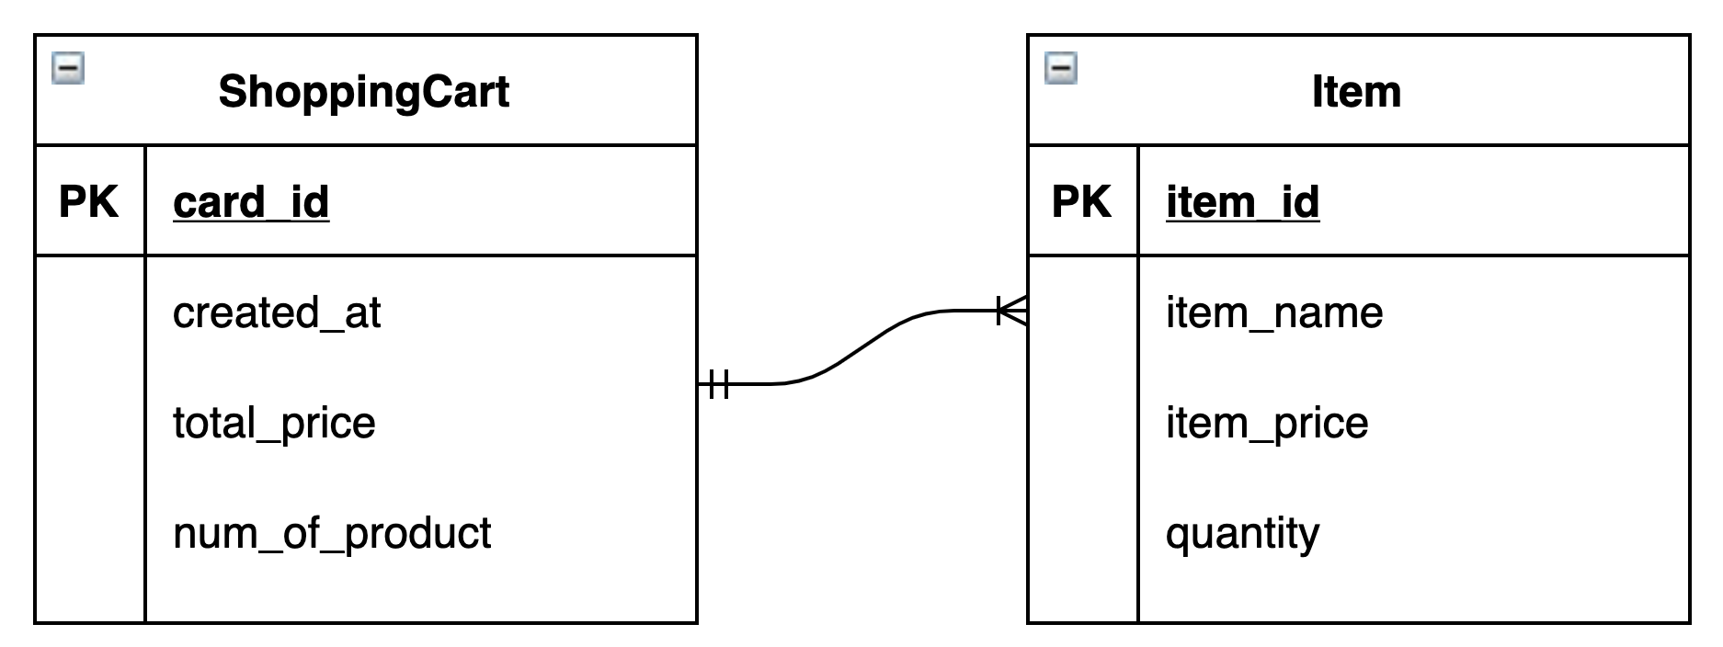
One to Many Relationship
One-to-many mapping means that one row in a table is mapped to multiple rows in another table.
In this situation, we use @OneToMany annotation on ShoppingCart side and @ManyToOne on Item side.

Slide 68
ShoppingCart.java

Slide 69
Item.java

Slide 70
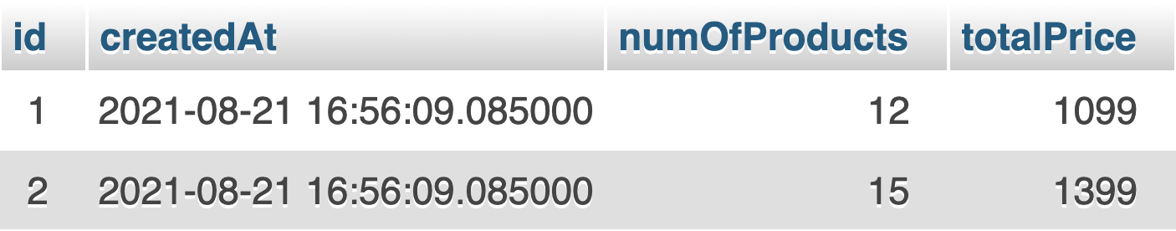
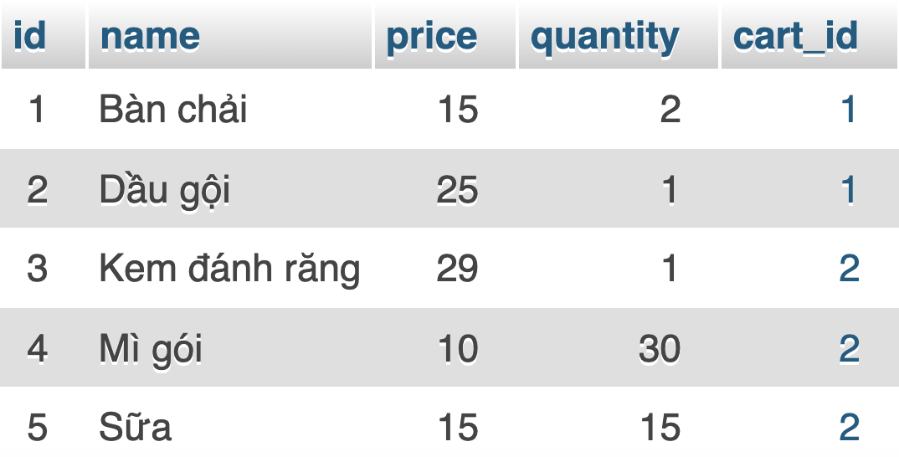

Slide 71
Many to Many
Relationship

Slide 72
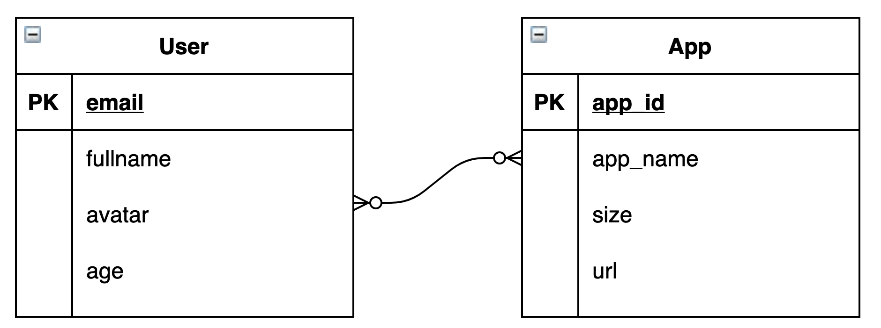
Many to Many Relationship
In the case of a many-to-many relationship, both sides can relate to multiple instances of the other side.
Let's take the example of user rating the app they like on App Store.

Slide 73
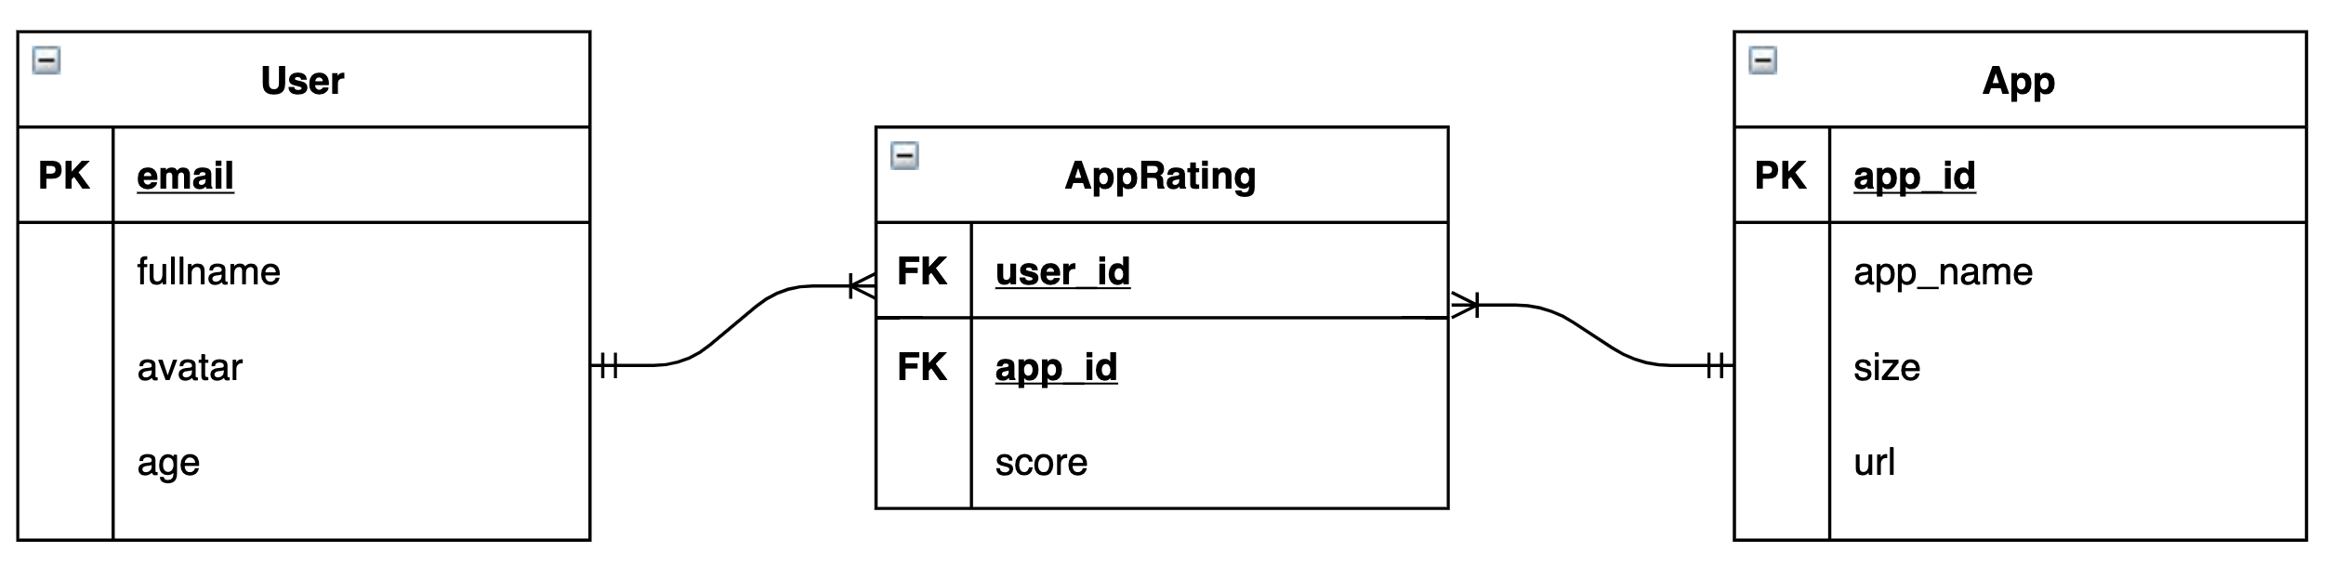
Many to Many Relationship
Since both sides should be able to reference the other, we need to create a separate table to hold the foreign keys.
In some cases, the many to many relationship also have properties.

Slide 78
